Slide 1

Application-layer traffic processing with eBPF
extended Barkeley packet filter
Bertrone Matteo – Polytechnic of Turin

Slide 2
BPF vs eBPF - classical BPF
BPF - Berkeley Packet Filter
Initially used as socket filter by packet capture tool tcpdump (via libpcap)
Introduced in Linux in 1997 in kernel version 2.1.75
Use cases:
Mainly socket filters (drop or trim packet and pass to user space)
used by tcpdump/libpcap, wireshark, nmap, dhcp ..

Slide 3
BPF vs eBPF - extended BPF
New set of patches introduced in the Linux kernel since 3.15 (June 8th, 2014) and into 4.0 (April 12th, 2015) and into 4.1 and 4.3
More registers (64 bit)
In-kernel JIT compiler (safe) : x86, ARM64, s390 …
“Universal in-kernel virtual machine”
Portable – any platform that LLVM compiles into will work
Use Cases:
Networking
Tracing (analytics, monitoring, debugging)

Slide 4
Extended BPF
Idea: improve and extend existing BPF infrastructure
Programs can be written in C and translated into eBPF
instructions using Clang/LLVM, loaded in kernel and executed
LLVM backend available to compile eBPF programs (llvm 3.7)
Safety checks performed by kernel
Added arm64, arm, mips, powerpc, s390, sparc JITs
ISA is close to x86-64 and arm64

Slide 5
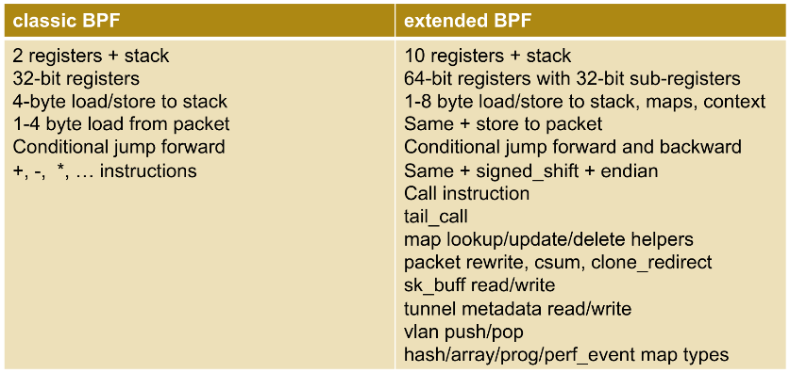
eBPF - low level VM architecture

Slide 6
eBPF new features - maps
BPF maps are key/value storage of different types.
Example
value = bpf_table_lookup(table_id, key) – lookup key in a table
Userspace can read/modify the tables
Generic memory allocated
Transfer data from userspace to kernel and vice versa
Share data among many eBPF programs (see next)
A map is identified by a file descriptor returned by a bpf() system call that creates the map
Attributes: max elements, size of key, size of value
Types of maps: BPF_MAP_TYPE_ARRAY, BPF_MAP_TYPE_HASH

Slide 7
eBPF – maps example
Restrictive C program to:
obtain the protocol type (UDP, TCP, ICMP, …) from each packet
keep a count for each protocol in a “map”:
int bpf_prog1(struct __sk_buff *skb)
{
int index = load_byte(skb, ETH_HLEN +
offsetof(struct iphdr, protocol));
long *value;
value = bpf_map_lookup_elem(&my_map, &index);
if (value)
__sync_fetch_and_add(value, 1);
return 0;
}

Slide 8
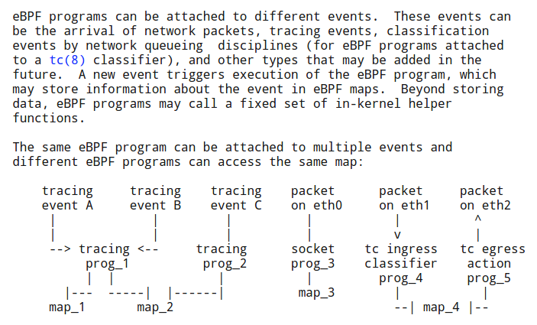
eBPF – maps sharing
http://man7.org/linux/man-pages/man2/bpf.2.html

Slide 9
EBPF – maps functions
BPF_PROG_LOAD: verify and load a BPF program
BPF_MAP_CREATE: creates a new map
BPF_MAP_LOOKUP_ELEM: find element by key, return value
BPF_MAP_UPDATE_ELEM: find element by key, change value
BPF_MAP_DELETE_ELEM: find element by key, delete it
BPF_MAP_GET_NEXT_KEY: find element by key, return key of next element

Slide 10

BCC – BPF Compiler Collection
https://github.com/iovisor/bcc

Slide 11
BCC – BPF Compiler Collection
BCC is a toolkit for creating efficient kernel tracing and manipulation programs. It makes use of eBPF (Extended Berkeley Packet Filters)
eBPF was described by Ingo Molnár as: “One of the more interesting features in this cycle is the ability to attach eBPF programs (user-defined, sandboxed bytecode executed by the kernel) to kprobes. This allows user-defined instrumentation on a live kernel image that can never crash, hang or interfere with the kernel negatively.”
BCC makes eBPF programs easier to write, with kernel instrumentation in C and a front-end in Python. It is suited for many tasks, including performance analysis and network traffic control.

Slide 12
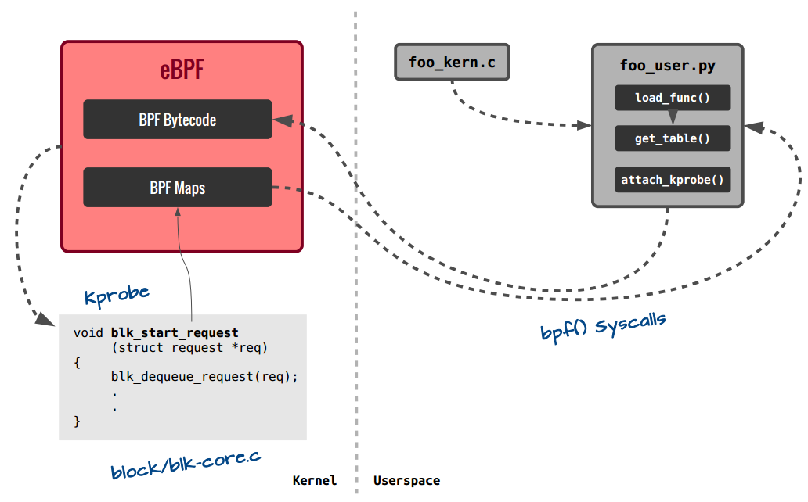
EBPF – Session workflow (.py + BCC)

Slide 13
EBPF – Session workflow (.py + BCC)
Write your BPF program in C... inline or in a separate file
Write a python script that loads and interacts with your BPF program
Attach to kprobes, socket, tc filter/action
Read/update maps
Configuration, complex calculation/correlations
Iterate on above and re-try...in seconds
https://github.com/iovisor/bcc

Slide 14
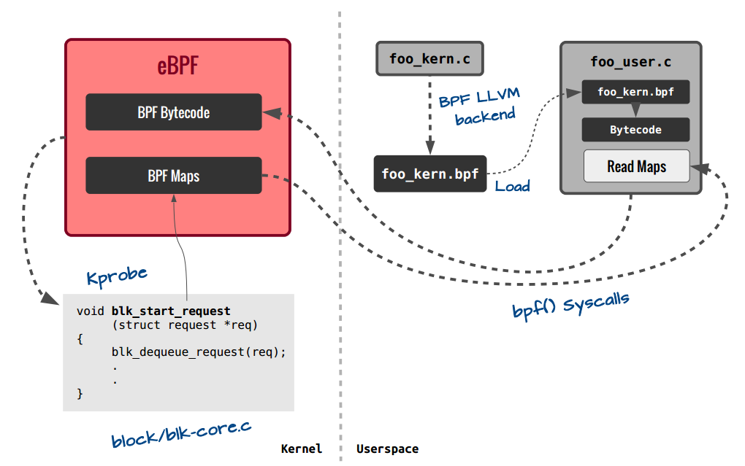
EBPF – Session workflow (c program)

Slide 15
EBPF – Session workflow (c program)
C API for working with BPF programs - libbpfprog.so
JIT compile a C source file to BPF bytecode (using clang+llvm)
Load bytecode and maps to kernel with bpf() syscall
Attach 1 or more BPF programs to 1 or more hook points
kprobe, socket, tc classifier, tc action

Slide 16
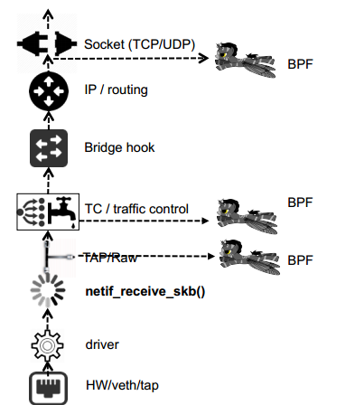
eBPF & Networking
Hooking into Linux networking stack (RX)
BPF programs can attach to sockets or the traffic control (TC) subsystem, kprobes, syscalls, tracepoints ...
sockets: STREAM (L4/UDP), DATAGRAM (L4/TCP) or RAW (TC)
This allows to hook at different levels of the Linux networking stack, providing the ability to act on traffic that has or hasn’t been processed already by other pieces of the stack
Opens up the possibility to implement network functions at different layers of the stack

Slide 17
eBPF & Networking
Hooking into Linux networking stack (TX)
Opens up the possibility to implement network functions at different layers of the stack

Slide 18
eBPF Retrieving Data
How userspace program can retrieve data from eBPF program running in in-kernel vm ?
Can read the <debugfs>/trace_pipe file from userspace (BCC wrap it to bpf_trace_printk())
Can retrieve registers values (they are the ctx)
Can read/write from maps

Slide 19
eBPF Limitation & Safety
Max 4096 instructions per program
Stage 1 reject program if:
  Loops and cyclic flow structure
  Unreachable instructions
  Bad jumps
Stage 2 Static code analyzer:
  Evaluate each path/instruction while keeping track of regs and stack states
  Arguments validity in calls

Slide 20
eBPF Usecases & Examples
Some eBPF example using BCC (from https://github.com/iovisor/bcc)
tools/tcpaccept: Trace TCP passive connections (accept()).
tools/tcpconnect:Trace TCP active connections (connect()).
examples/distributed_bridge/: Distributed bridge example.
examples/simple_tc.py: Simple traffic control example.
examples/tc_neighbor_sharing.py: Per-IP classification and rate limiting.
examples/tunnel_monitor/: Efficiently monitor traffic flows.
examples/vlan_learning.py: Demux Ethernet traffic into worker veth+namespaces.

Slide 21
Links
https://github.com/iovisor/bcc
https://github.com/iovisor/bpf-docs
http://lwn.net/Articles/603984/
http://lwn.net/Articles/603983/
https://lwn.net/Articles/625224/
https://www.kernel.org/doc/Documentation/networking/filter.txt
http://man7.org/linux/man-pages/man2/bpf.2.html
https://linuxplumbersconf.org/2015/ocw//system/presentations/3249/original/bpf_llvm_2015aug19.pdf
https://videos.cdn.redhat.com/summit2015/presentations/13737_an-overview-of-linux-networking-subsystem-extended-bpf.pdf
https://github.com/torvalds/linux/tree/master/samples/bpf
https://suchakra.wordpress.com/2015/05/18/bpf-internals-i/
https://suchakra.wordpress.com/2015/08/12/bpf-internals-ii/
http://events.linuxfoundation.org/sites/events/files/slides/tracing-linux-ezannoni-linuxcon-ja-2015_0.pdf

